Slide 1
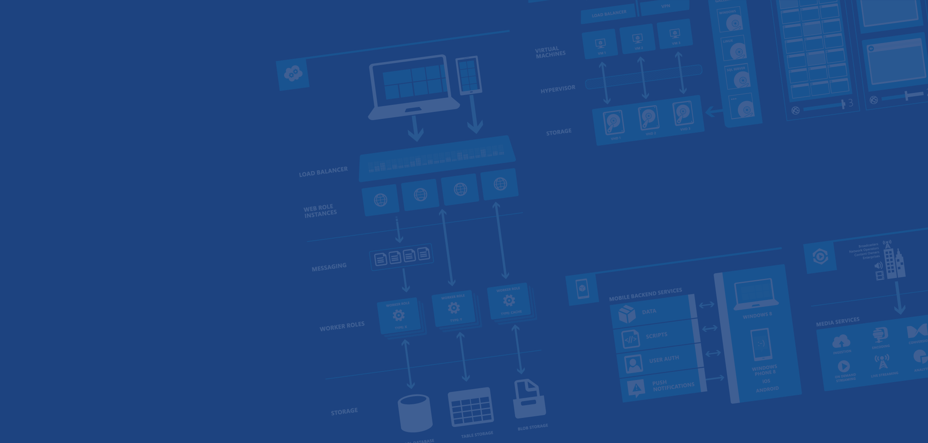
Azure IaaS
Nikos Tzelvenzis
Developer - Operations
Microsoft Azure
Notes:
Presentation Objectives:
This presentation provides a high-level overview of AzureIaaS. It covers essential conceptsand tools for people who are new to Azure to get started. It covers both Virtual Machines and Virtual Networks.
Speaker Notes:
It’s important for the speaker to reiterate the first segment, which should have been covered by the “Design Cloud Solutions” session earlier.
Given there are lots of contents to be covered, the speaker should focus on only high-level concepts instead of drilling too much into details.
<number>

Slide 2
Agenda
→Your services and Azure
→Virtual machines
→Virtual networks
Notes:
Slide Objectives:
Explainthe agenda of the session.
Speaker Notes:
Explainthis presentation is a high-level overview, so not everything is covered in-depth.
<number>

Slide 3
Your service
Notes:
Slide Objectives:
Explain how Azure helps developers to refocus on their applications.
Speaker Notes:
Before we discuss about specifics, let’s refocus on what you care about – your application/service.
Azure is taking a application-centric approach and brings tools and services to supportDevOpsscenarios.
<number>

Slide 4
→Yourapplication code
→Required resources
→Yourinfrastructurecode
Notes:
Slide Objectives:
Explain application is made up by application code and infrastructure code.
Speaker Notes:
Let’s start with something that you know inside-and-out: your application code. [click]
Then,for whatever reason, you decide to deploy your application to Azure. [click]
What you do is to allocate a bunch of related resources out of the humongous resource pool provided by Azure, deploy your application code to these resources, and you have a running service. [click]
ForDevOps’ perspective, you need a way to reliable capture and apply your requirements on resources, which can be referred as infrastructure code.
<number>

Slide 5
You:Code (application, infrastructure)
Azure:Resources (IaaS,PaaS, SaaS)
Notes:
Slide Objectives:
Reiterate the point that to make your service successful, you are partnering with Azure. You bring the code, and Azure brings resources.
This slide also sets state for the talk by explaining howIaaScomponents fit into the overall picture.
Speaker Notes:
[Continuewith previous slide]
To make your service successful, you are partnering with Azure. You bring the code, and Azure brings resources. [Click]
And you keep iterating and making improvements over time. [Click]
In terms of infrastructure code, you can use it to define desired states of required resources (Note: current Azure ResourceManager only support a small number of Resource Providers). [Click]
You can define hosting environments, such as websites, cloud services and VMs. [Click]
Required services. [Click]
In this session we’ll focus on infrastructural components including virtual machines and virtual networks.
<number>

Slide 6
Virtual Machines
Notes:
<number>

Slide 7
AzureVirtual Machines
→LaunchWindows Server and Linux in minutes
→Scalefrom 1 to 1000s of VM Instances
→Savemoney with per-minutebilling
→Open and extensible
Notes:
Slide Objectives:
High-level selling points of virtual machines.
Speaker Notes:
BothLinux and Windows are supported. It’s important to reiterate on this as many developers are still not aware of this.
Mention scaling at enterprise level using DSC, Puppet or Chef.
Emphasize on the openness – we are not forcing your to lock on Microsoft technologies. Instead, Azure is more open than ever. You can leverage your existing skills, tools and services, and Azure is providing more and more first-class supports for them.
<number>

Slide 8



Provisioning VM
Getting Started
Select Image and VM Size
New Disk Persisted in Storage
Windows Server
Management Portal
Boot VM from New Disk
Linux
>_
General Purpose
Basic
Standard
Optimized Compute
Performance Optimized
Network Optimized
Scripting
(Windows, Linux and Mac)
Cloud
REST API
Notes:
SlideObjective:
Explainworkflow for provisioning VMs in the cloud
Speaker Notes:
You have three methods of starting this process: Build a VM from the portal, from the command line OR programmatically calling the REST API.
Once your choice of provisioning is made you will need to select the image and instance size to start from.
The newly created disk will be stored in blob storage and your machine will boot.
<number>

Slide 9


















VM Gallery
A collection of prebuilt images for various workloads
WindowsServer 2012 R2
Ubuntu Server 14.04 LTS
CentOS6.5
SUSE Linux
Enterprise Server
openSUSE13.1
Oracle Linux 6.4.0.0.0
SQLServer 2014 Standard
Oracle Database 11g R2
SharePoint Server Farm
Microsoft Dynamics
GP 2013
Zulu 8
BizTalk Server 2013
SAP HANA
Developer Edition
Puppet Enterprise 3.2.3
Barracuda Web Application
Oracle WebLogic
Server 12.1.2
Visual Studio Ultimate 2013
Windows 8.1 Enterprise
Microsoft Azure
<number>
Notes:
SlideObjective:
Explaina wide variety of images that you can choose from.
Speaker Notes:
Firstof all, you can choose from different Windows Servers and a variety of Linux implementations. [Click]
As well as pre-built images fordifferent flavors of SQL Database and Oracle databases. [Click]
You can also choose from a number of first-party and certified third-party images for various application servers and infrastructural components. [Click]
And last but not least, if you are a MSDN subscriber, you also have access to VisualStudio images and client Windows systems such as Windows 7 and Windows 8.1 for yourDevTestpurposes.
<number>

Slide 10
Virtual Machine Sizes
GeneralPurpose compute: Basic
General Purpose compute: Standard
Optimized Compute
Performance Optimized
Network Optimized
Notes:
SlideObjective:
Introduce different virtual machine sizes.
Speaker Notes:
http://azure.microsoft.com/en-us/pricing/details/virtual-machines/
<number>

Slide 11
General purpose compute: Basic tier
An economical option for development workloads, test servers, and other applications that don't require load balancing, auto-scaling, or memory-intensive virtual machines.
Instance | Cores | RAM | Disk sizes
A0 | 1 | 0.75 GB | 20 GB
A1 | 1 | 1.75 GB | 40 GB
A2 | 2 | 3.5 GB | 60 GB
A3 | 4 | 7 GB | 120 GB
A4 | 8 | 14 GB | 240 GB

Slide 12
General purposecompute: Standardtier Offers the most flexibility. Supports all virtual machine configurations andfeatures
Instance | Cores | RAM | Disk sizes
A0 | 1 | 0.75 GB | 20 GB
A1 | 1 | 1.75 GB | 70 GB
A2 | 2 | 3.5 GB | 135 GB
A3 | 4 | 7 GB | 285 GB
A4 | 8 | 14 GB | 605 GB
A5 | 2 | 14 GB | 135 GB
A6 | 4 | 28 GB | 285 GB
A7 | 8 | 56 GB | 605 GB

Slide 13
Optimizedcompute 60% faster CPUs, more memory, and local SSD
Instance | Cores | RAM | Disk sizes
D1 | 1 | 3.5 GB | 50 GB
D2 | 2 | 7 GB | 100 GB
D3 | 4 | 14 GB | 200 GB
D4 | 8 | 28 GB | 400 GB
D11 | 2 | 14 GB | 100 GB
D12 | 4 | 28 GB | 200 GB
D13 | 8 | 56 GB | 400 GB
D14 | 16 | 112 GB | 800 GB

Slide 14
Performance optimizedcomputeUnparalleledcomputational performance with latest CPUs, more memory, and more local SSD
Instance | Cores | RAM | Disk sizes
G1 | 2 | 28 GB | 384 GB
G2 | 4 | 56 GB | 768 GB
G3 | 8 | 112 GB | 1,536 GB
G4 | 16 | 224 GB | 3,072 GB
G5 | 32 | 448 GB | 6,144 GB

Slide 15
Networkoptimized Fastnetworking withInfinibandsupport Adds a 40Gbit/sInfiniBandnetwork with remote direct memory access (RDMA) technology. Ideal for Message Passing Interface (MPI) applications, high-performance clusters, modeling and simulations, video encoding, and other compute or network intensive scenarios.
Instance | Cores | RAM | Disk sizes
A8 | 8 | 56 GB | 382 GB
A9 | 16 | 112 GB | 382 GB

Slide 16
Demo: Provisioning VM
Managing VMs using Azure portal
Notes:
Demo:Provisioning VM
Prerequisites:
A Windows Server 2012 is already provisioned.
Steps:
OpenIbiza portal and click theNEWbutton at the lower-left corner.
Show the short list of resources. Explain that I can directly create popular resources here such as a Windows Server 2012.
Click on theEverythinglink.
InGalleryblade, open theVirtual machinescategory.
Scroll down the view and show images of different types (refer back to slide 9).
Click onWindows Server 2012 R2, and then click theCreatebutton in the overview blade. For non-Microsoft focused audience, consider to pick a Linux image instead.
Fill in theCreate VMform and click on theCreatebutton to provision the VM. Explain this will take a few minutes.
Open the already provisioned VM.
Scrolldown the blade to show various of information available on the blade.
Click on theExtensionstile.
On theExtensionsblade, click on theADDicon to bring up the extension list. Introduce that VM extensions areinstallable components to customize VM instances.
Switch to slides to continue with VM extension introduction.
<number>

Slide 17
VirtualNetworks
Notes:
<number>

Slide 18
AzureVirtual Networks
→A protected private virtual network in cloud
→Extend enterprise networks into Azure
→Cross-premises connectivity
Notes:
<number>

Slide 19
Virtual Network Scenarios
Hybrid Public/Private Cloud
Enterprise appin Microsoft Azurerequiring connectivity toon-premiseresources
Enterprise Identity and Access Control
Manage identity and access control withon-premiseresources (on-premises Active Directory)
Monitoring and Management
Remote monitoring and trouble-shooting of resources running in Azure
Advanced Connectivity Requirements
Cloud deployments requiring IP addresses and direct connectivity across services
Microsoft Azure
<number>

Slide 20






Cross-premises Connectivity
Site-to-site
Create a secure connection between your on-premises site and your virtual network
Point-to-site
Create a secure connection via VPN to your virtual network
ExpressRouteTM
Create a private connection between Azure data centers and infrastructures on your premises or in a co-location environment.
Connect at anExpressRoutelocation (Exchange Provider facility)
Direct connect via a Network Service Provider
Microsoft Azure
<number>

Slide 21
Demo: Virtual Network
Point-to-Site connection
Notes:
Demo:Point-to-Siteconnection
Prerequisites:
Follow step 1-15 below to prepare the environment.
(http://haishibai.blogspot.com/2013/05/walkthrough-file-sharing-between-your.html)
Steps:
Run through steps 17-21 in the following steps. If time permits, you can start with step 16.
Log on to (current)Microsoft Azure Management Portal.
On command bar, click onNEWbutton, then selectNETWORKS->VIRTUAL NETWORK->CUSTOMCREATEmenu.
OnVirtual Network Detailspage, enter networkNAMEaspointtosite, create or select aAFFINITY GROUP, then click next arrow.
OnDNS Servers and VPN Connectivitypage, checkConfigure Point-to-Site VPN, then click next arrow:
OnPoint-to-Site Connectivitypage, click next arrow.
OnVirtual Network Address Spacespage, click onadd gateway subnetbutton, and then click on check icon to complete network creation.
After the virtual network has been created, open itsDASHBOARDpage, and the clickCREATE GATEWAYicon to create the dynamic routing gateway.
Add a new Windows Server 2012 virtual machine to the virtual network. Note that when you specify user credential, make sure touse the same user id and password of your local account. This is because the virtual machine on Microsoft Azure is not under your domain controller, and we are using the same user credential on both local and virtual machines to allow file sharing.
As the virtual machine is cooking, let’s create two self-signed certificates: one for root, and another for client identification. During the following steps we’ll need to upload the root certificate to Microsoft Azure so Microsoft Azure can validate the client machine using the certificate chain.
LaunchDeveloper Command Prompt for VS2012as administrator. Change current folder to a folder where you want to keep the generated certificates. Here I’ll use folderc:\books.
Use commandmakecert-sky exchange -r -n "CN=MyFakeRoot" -pe-a sha1 -len2048 -ssMy to create root certificate.
Use commandmakecert-n "CN=MyLaptop" -pe-sky exchange -m 96 -ssMy -in "MyFakeRoot" -is my -a sha1 to create client certificate.
Launchcertmgr. Export the root certificate as aMyFakeRoot.cerfile (withoutprivate key).
[Optional] if you are configuring VPN for another client, you’d need to install the client certificate on target machine.
Go back to Microsoft Azure Management Portal. OnDASHBOARDpage of the virtual network, click on linkUpload client certificateto upload the root certificate. Note at this point the gateway should have been created.
After certificate has been uploaded, you can download and install VPN client from theDASHBOARDpage (AMD64 Clientlink for 64-bit machines,x86 Clientlink for 32-bit machines).
After VPN client has been installed, you can see the VPN connection on your Windows network connection list. Click on the network to connect. When prompted by the VPN client, clickConnectbutton to continue.
[Optional] Now you can useipconfig/allto verify if VPN connection has been successfully established (look for PPP adapter).
Log on to the virtual machine, create a newSharefolder underc:\. Share the folder with the user you specified when you created the virtual machine.
On Management Portal, record the virtual machines private IP on itsDASHBOARDpage. In my case the IP is 10.0.1.4.
Now you can use Explorer on your local machine and access the shared folder by \\10.0.1.4\Share.
<number>

Slide 22

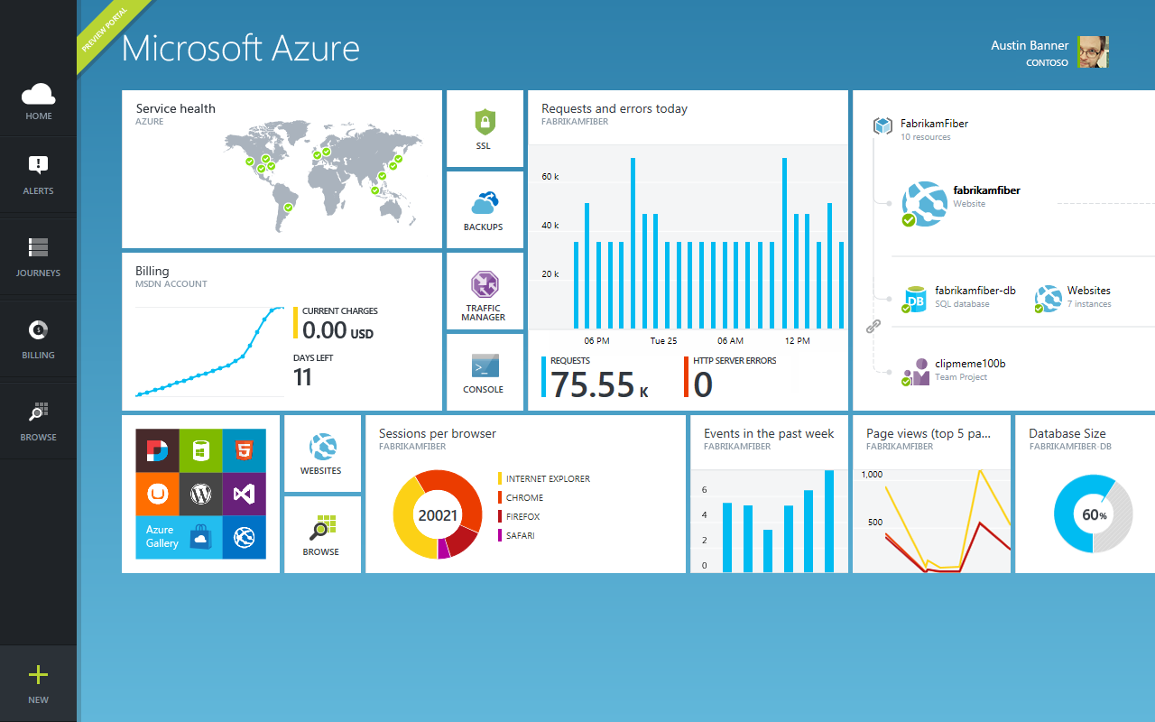
Getstarted
Visit azure.microsoft.com
Notes:
Build 2012
© 2012 Microsoft Corporation. All rights reserved. Microsoft, Windows, and other product names are or may be registered trademarks and/or trademarks in the U.S. and/or other countries.
The information herein is for informational purposes only and represents the current view of Microsoft Corporation as of the date of this presentation. Because Microsoft must respond to changing market conditions, it should not be interpreted to be a commitment on the part of Microsoft, and Microsoft cannot guarantee the accuracy of any information provided after the date of this presentation. MICROSOFT MAKES NO WARRANTIES, EXPRESS, IMPLIED OR STATUTORY, AS TO THE INFORMATION IN THIS PRESENTATION.
23/4/2015
<number>

